Slide 1
Applications of Computer Science
By Waseem Akram

Slide 2
Computer science
Computer science is the study of principles and use of computers

Slide 3
Applications of Computer Science
Health and Medicine
Education
Banks
Engineering

Slide 4
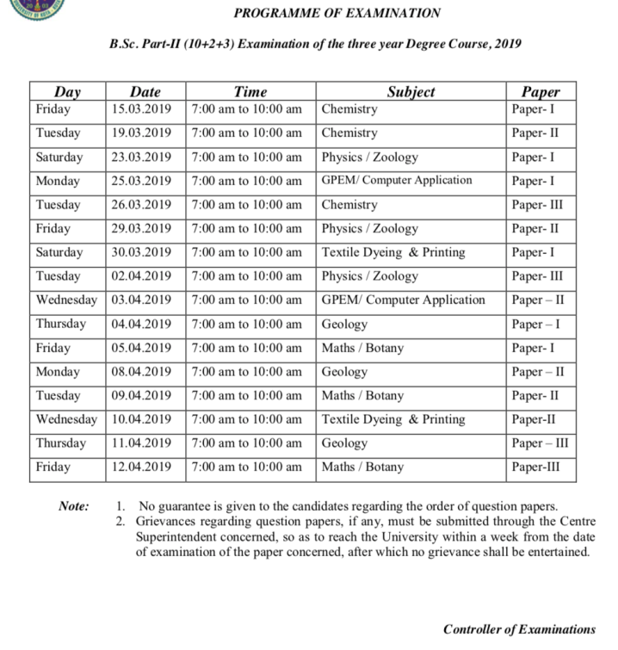
Education
Preparing time-table Computers help in preparing time-table, schedules, etc.

Slide 5

Education
Guidance
Computer helps the teacher in providing information/data for guidance and reference.

Slide 6
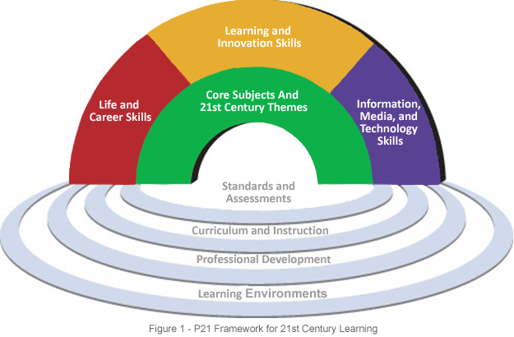
Education
Problem-solving and creativity
Computers can be used to develop Problem-solving ability and creativity among the students.

Slide 7
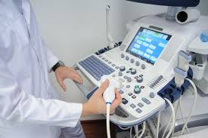
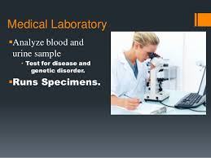
Health and Medicine
Hospital information system
Data Analysis in Medicine
Medical imaging
Laboratory Computing
Care of critically ill patients

Slide 8
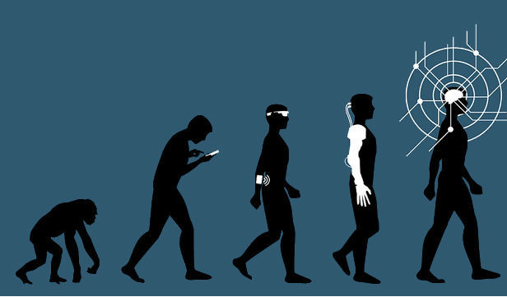
Artificial intelligence in future
Increase security
Improve healthcare
Make humans smarter
Empower businesses

Slide 9
THANKS

